Slide 1


Slide 2

Skill 17
Web Development

Slide 3
Module Overview
 | C1 | C2 | C3
Morning | Module A Static Website Design 3h | Module C Backend API 3h | Module E Advanced Web Development 3h
Afternoon | Module B Backend SSR 4h | Module D Frontend 4h | Module F Collaborative Challenge 2h
Notes:
Module A: Implement a static website for a client. Competitors are given structure, breaktpoints. No render frameworks allowed!
Module B: Implement a backend with a database. The backend renders HTML pages.
Module C: Implement a backend which provides a REST API. The solution of module B will be provided (backend & database dump). Competitors have to extend the provided database.
Module D: Implement a frontend which consumes the REST API from Module C. The solution of module C will be provided.
Module E: Competitors will receive 3 separate tasks which all involve using native and advanced Web features that the browser provides. Frameworks will not be used.
Module F: Competitors form groups and collaboratively work on a creative idea and then present it to the other groups.

Slide 4
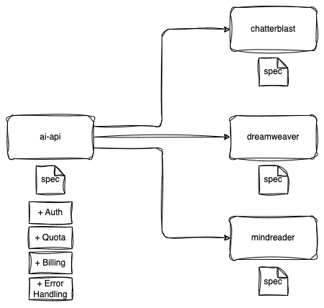
Module C

Slide 5
Module C

Slide 6
Module C

Slide 7
Module C

Slide 8
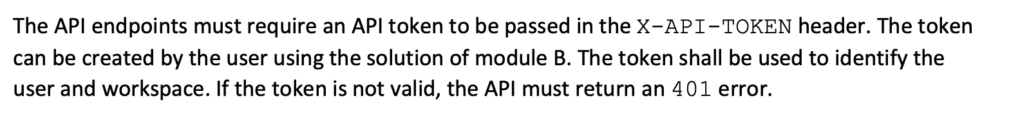
Module C - Authentication

Slide 9
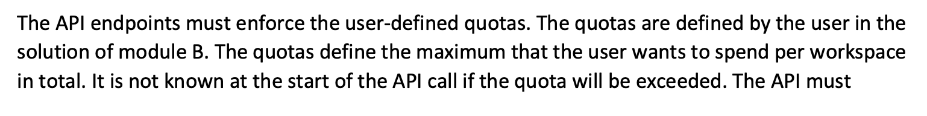
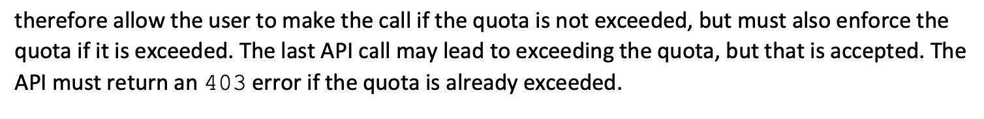
Module C - Quotas

Slide 10
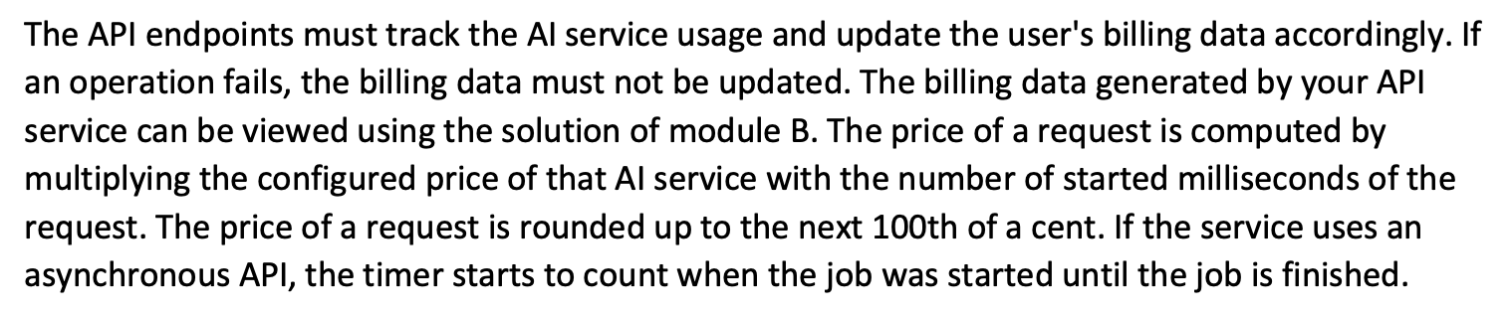
Module C - Billing

Slide 11
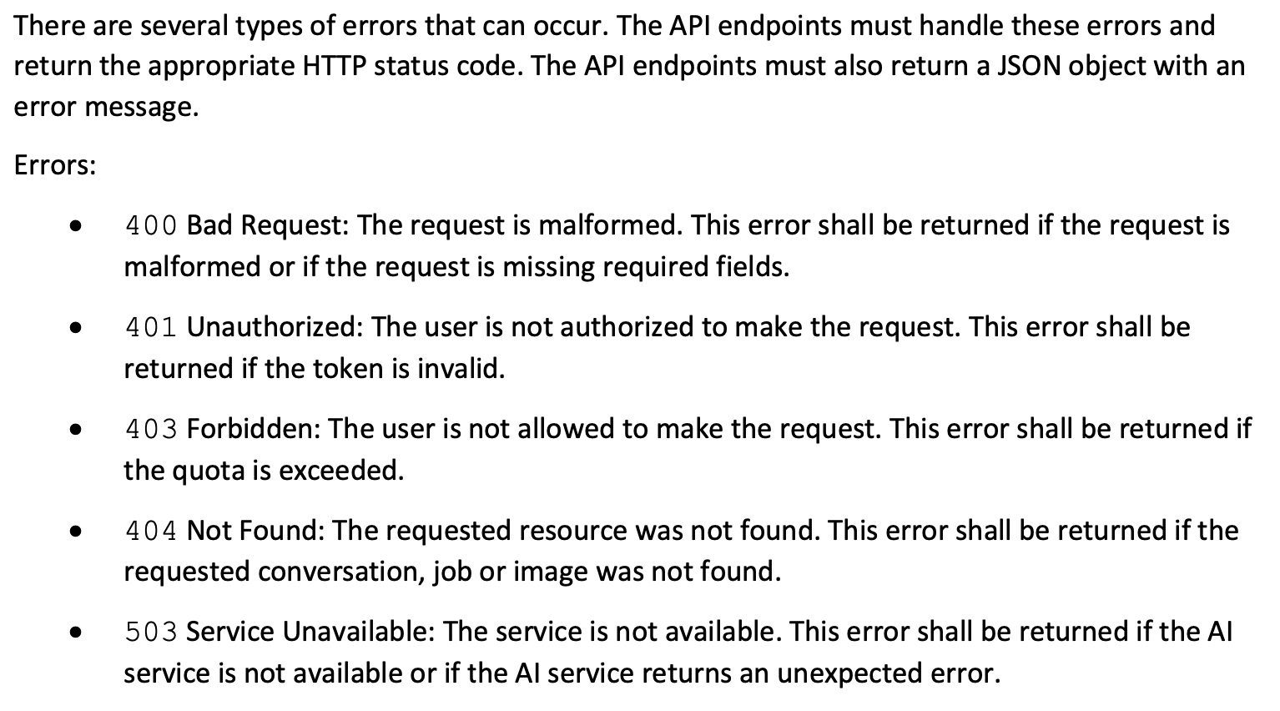
Module C - Error Handling

Slide 12
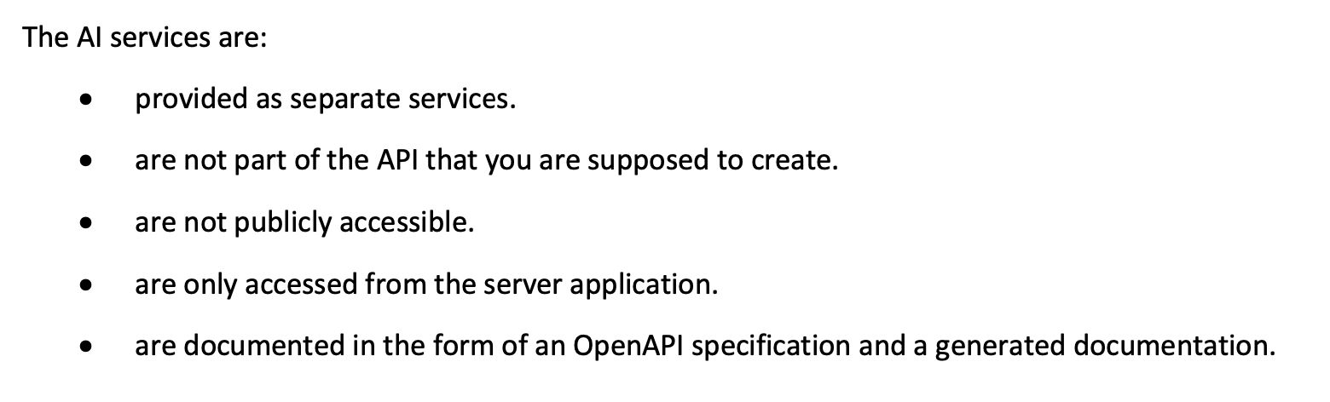
Module C - AI Services

Slide 13
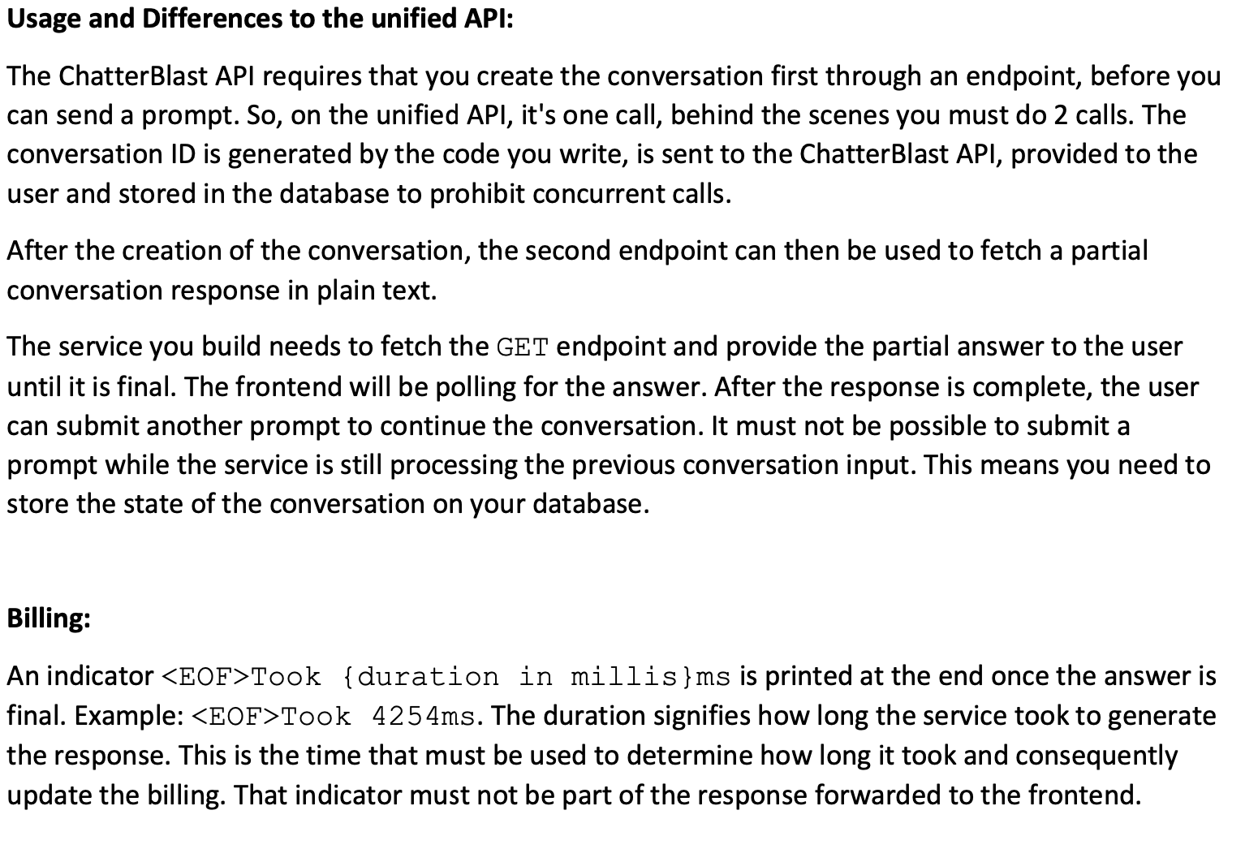
Module C - ChatterBlast

Slide 14
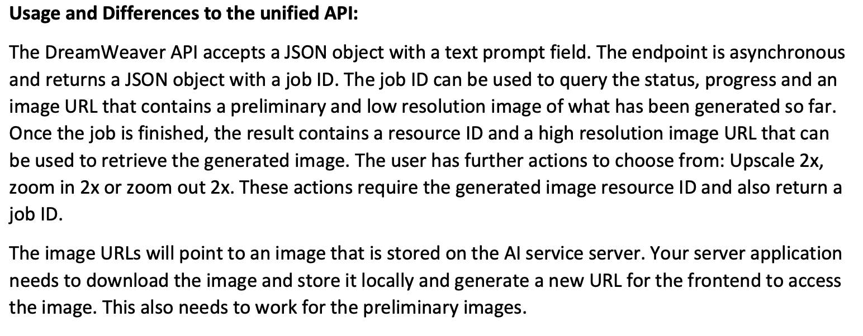
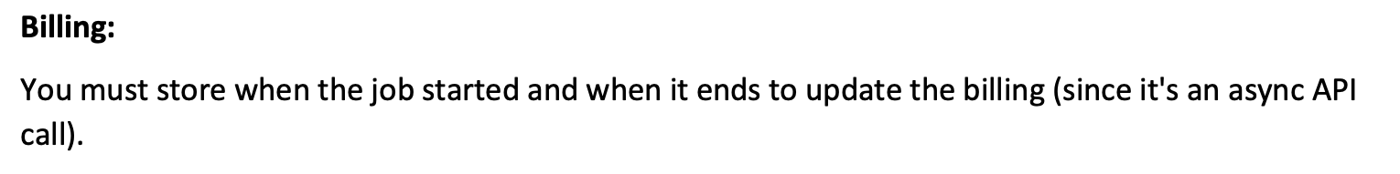
Module C - DreamWeaver

Slide 15
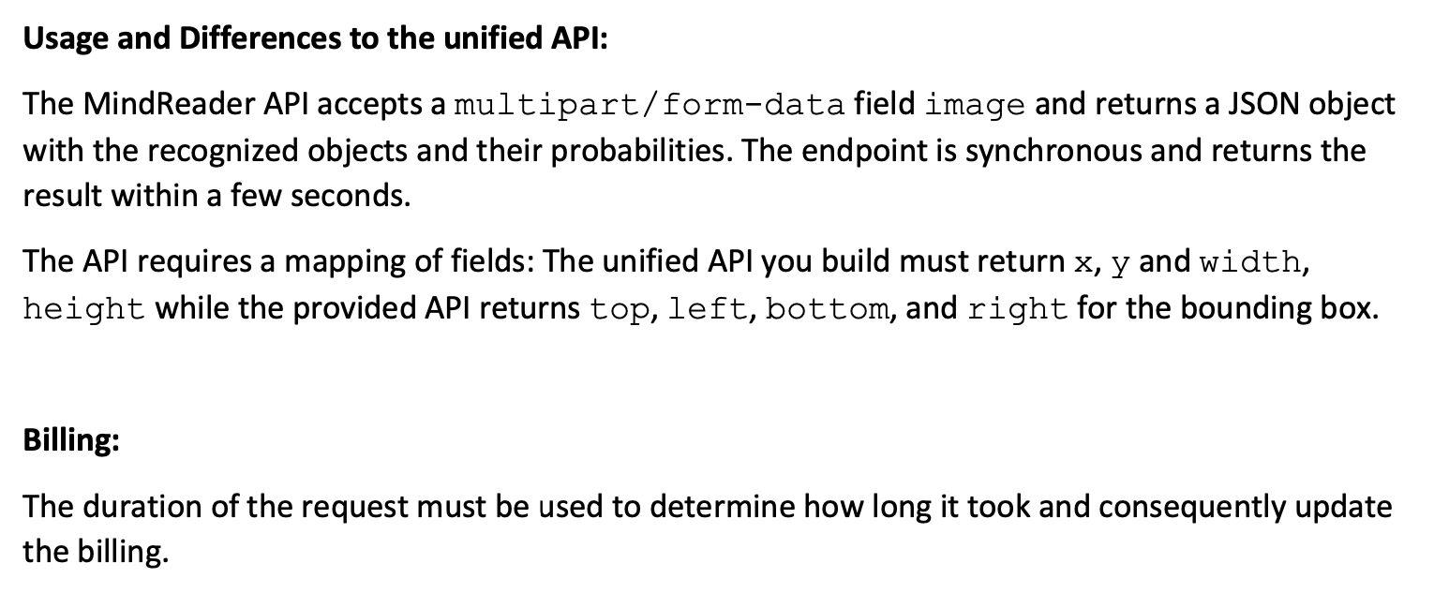
Module C - MindReader

Slide 16


